Slide 1
User Interface
User interface provides interaction between user and ES
It explains how the ES has arrived at a particular recommendation in the following forms
Natural language displayed on screen.
Verbal narrations in natural language.
Listing of rule numbers displayed on the screen.

Slide 2

Knowledge Acquisition Facility
Knowledge acquisition facility
Provides a convenient and efficient means of capturing and storing all components of the knowledge base
Knowledge base
Knowledge acquisition facility

Slide 3
Shell
Shells come equipped with an inference mechanism
Require knowledge to be entered according to a specified format
Other features
Tools for writing hypertext
Constructing friendly user interfaces, for manipulating lists, strings, and objects, and for interfacing with external programs and databases

Slide 4
Shells − A shell is nothing but an expert system without knowledge base. A shell provides the developers with knowledge acquisition, inference engine, user interface, and explanation facility. For example, few shells are given below −
Java Expert System Shell (JESS) that provides fully developed Java API for creating an expert system.
Vidwan, a shell developed at the National Centre for Software Technology, Mumbai in 1993. It enables knowledge encoding in the form of IF-THEN rules.

Slide 5
EXPERT SYSTEM SHELLS
The systems were constructed as a set of declarative representations (mostly rules) combined with an interpreter for those representations,
it was possible to separate the interpreter from the domain-specific knowledge and thus to create a system that could be used to construct new expert systems by adding new knowledge corresponding to the new problem domain.

Slide 6
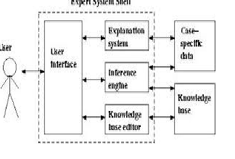
Architecture of Expert System Shells

Slide 7
Expert Systems Development
Determining requirements
Identifying experts
Construct expert system components
Implementing results
Domain
The area of knowledge addressed by the expert system.
Maintaining and reviewing system

Slide 8
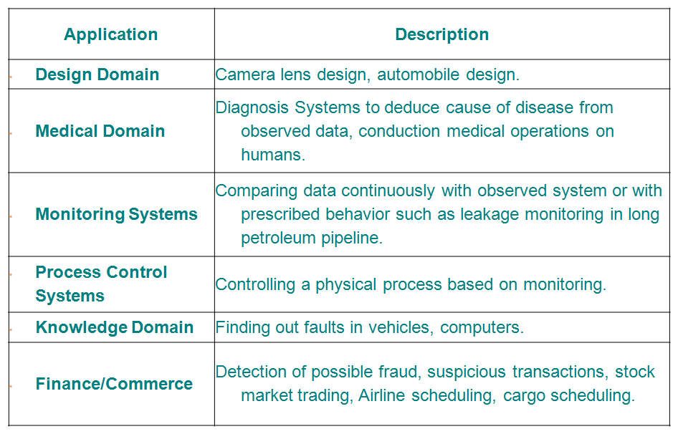
Applications of Expert Systems

Slide 9
Advantages
Consistent answers for repetitive decisions, processes and tasks
Holds and maintains significant levels of information
Encourages organizations to clarify the logic of their decision-making
Never "forgets" to ask a question, as a human might

Slide 10
Disadvantages
Lacks common sense
Cannot make creative responses as human expert
Domain experts not always able to explain their logic and reasoning
Errors may occur in the knowledge base
Cannot adapt to changing environments

Slide 11
